Slide 1
Learn With You
Github
伴伴學
Accomdemy

Slide 2

Accomdemy
Accompany+Academy

Slide 3
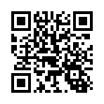
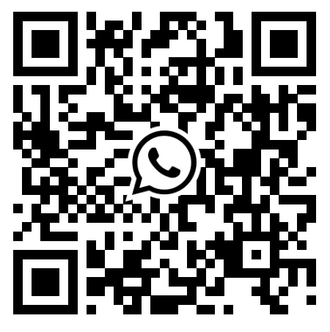
Facebook
Group
WhatsApp
Group

Slide 4
After this......
Teach forward and pass your learnings to someone else
Post a review in the community or on your social media

Slide 5
Why learn Github？
Git & GitHub Things you should know earlier

Slide 6
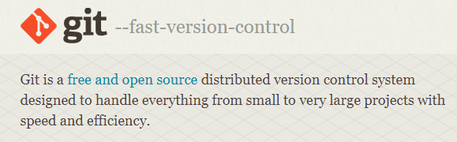
Reasons-1

Slide 7

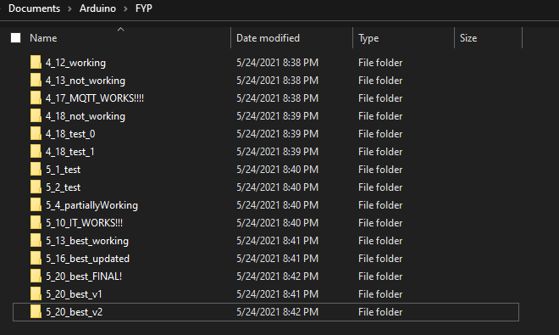

Slide 8
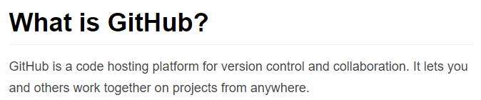

Reasons-2
GitHub

Slide 9
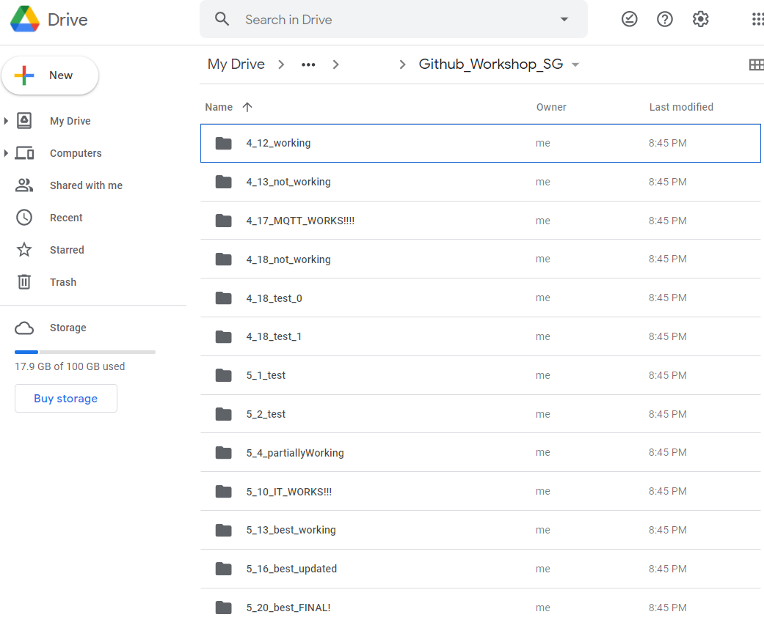

Slide 10
Why learn github first?

Slide 11

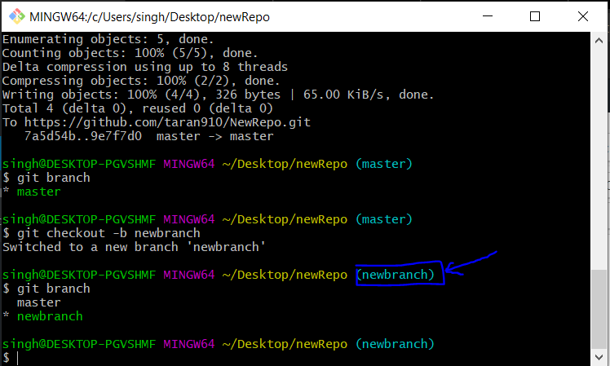

Slide 12

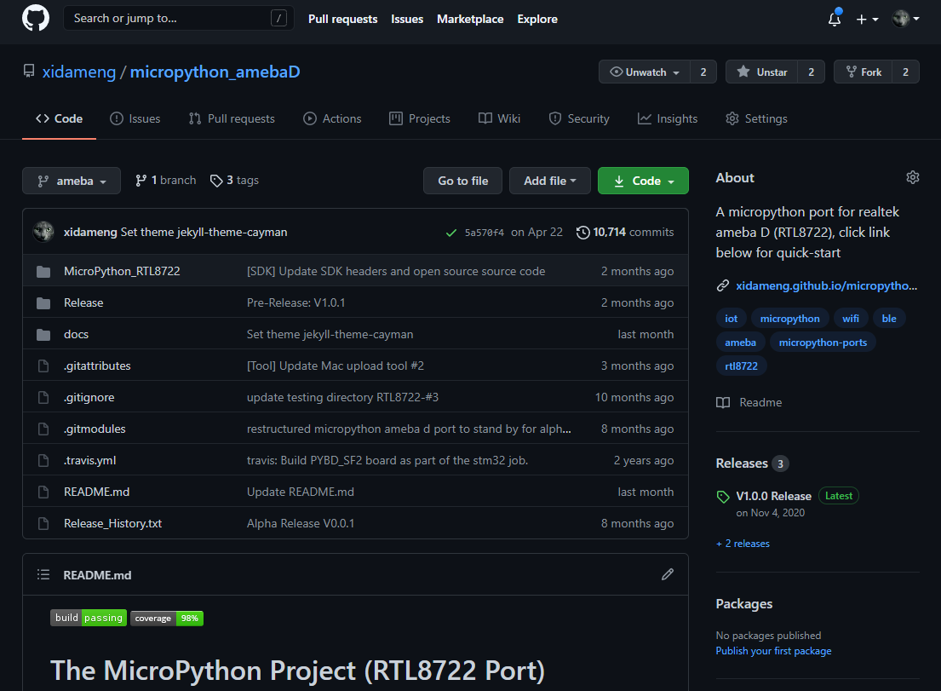

Slide 13
STEP 1：Create repo
Register a Github account
Create a repo
Tick the box of creating a README.md
Choose a license(optional)
Notes:
License: is used when someone is forking others repos

Slide 14
STEP 2：Add files
You may add code, text or other file format
Add new file (any file)
Edit your README.md and describe what this repo is about
why?
How to use
Future plan / how to contribute

Slide 15
Markdown explained

Slide 16
STEP 3：Delete
Delete items and leave a msg
STEP 4：Edit
Edit items and leave a msg

Slide 17
STEP 5：Fork
Click fork and make a copy of other’s repo under your account
STEP 6：Pull Request (PR)
Make a change to a file and commit
Create a PR to the original repo

Slide 18
Future Topics
Github desktop application
Readme.md advanced usage
Branch and co-work

Slide 19
Summary

Slide 20
If you need someone to learn with you...
Facebook
Group
WhatsApp
Group

Slide 21
Next Study Guide (any recommendations?)

